Slide 1
Alexander (Greek) Thomson
S2 ARCHITECTURE. WEEK BEGINNING 25/5/2020

Slide 2
Born 1817 Died 1875

Slide 3
Who was he?
Alexander (Greek) Thomson was a well known SCOTTISH architect
Though to be one of the greatest architect of the Western world
He designed a wide range of buildings including a CASTLE,WAREHOUSES, TENEMENTS, TERRACES, and CHURCHES

Slide 4
Look On your iPad or phone and see where THOMSON WAS BORN and where he died

Slide 5
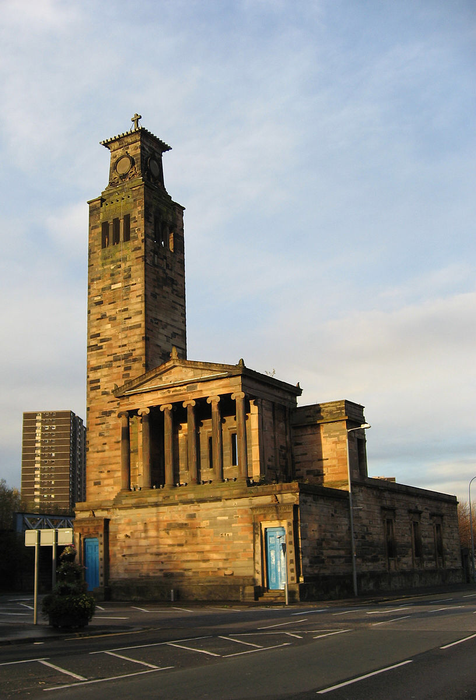
He used the styles of GREEK and ROMAN ARCHITECTURE TO HELP HIM WITH HIS DESIGNS
Have you learned anything about ancient architecture you can see in Thomson’s work?
Below is a photograph of one of Thomson’s churches

Slide 6
Caledonia rd church

Slide 7
Why should we conserve this building
Why would we destroy this building?
Why would we keep the building?
What else could this building be used for?
Can you think of words to describe this building?

Slide 8
The union street ‘Egyptian halls’ Glasgow

Slide 9
Do you recognise this building ?

Slide 10
‘Egyptian halls’
This building was designed in around 1870
The building is empty at the moment but has funding to convert it into a hotel
The building materials are cast iron and stone
The building has Greek & Egyptian details such as Roman style columns and lotus flower capitals
Thomson said ‘ the client is very proud of the building…. Probably my most successful effort’
What is YOUR opinion of the building? Have you walked passed this building?

Slide 11
Www.scotcities.com – only do this task if you are able to.
Please log onto the above website click on Alexander Greek Thomson ( right hand column) and answer the following questions-
1) Where did Alexander Greek Thomson work?
2) Look at the photograph and drawings of his architecture ( buildings) Write down three examples of his buildings.
3) What is you opinion of the buildings and why?

Slide 12
Drawing task
Look at an example of Greek Thomson’s architecture on line.
Choose a part of it ( for example a column or a window) and make a drawing of this in pencil or in pen.

