Slide 1
Welcome to St Mungo’s Academy P7 Family Information Evening 20.05.24

Slide 2
School Prayer
Father,
We the community of St Mungo’s ask you to help us prepare ourselves for each day ahead.
Give us the strength to care for one another and the courage to do what is right and best for ourselves and others.
Help us to be positive and always stay true to our Christian faith.
Thank you for being there.
AMEN
St Mungo, pray for us.

Slide 3
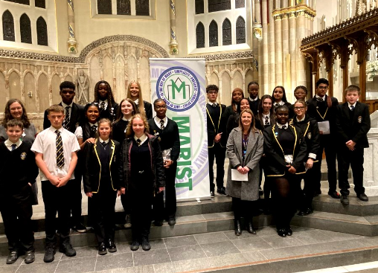
Community of Faith
Two periods of Religious Education each week
School values of Faith, Hope and Love underpin our daily practice in all subjects
Advent and Lenten charity work
Living out Gospel values each day
Zero tolerance for bullying
Gold Rights Respecting School
Notes:
St Mungo's Academy is a community of faith and although we are a Catholic School we are a school open to all faiths and those who have none. Our faith values underpin our work through two periods each week of religious education, charity work for our local community and expecting everyone to be treated with respect regardless of faith, culture, gender or ethnic background.

Slide 4
Notes:
The Charter for Catholic Schools in Scotland summarizes the key characteristics which all Catholic schools in Scotland strive to feature through the experiences and the service which they offer. More info on the Charter can be found here: Scottish Catholic Education Service | SCES | Charter for Catholic Schools

Slide 5
Our Vision Values & Aims
Improved quality and consistency of digital learning and teaching
Parents feel supported and empowered to improve outcomes for pupils
Wellbeing of stake holders planned and supported in a sustainable way, including through an equalities agenda and a focus on Mental Health
A curriculum which supports the needs of all learners
Notes:
Our school VVA were created through consultation with staff and learners, and will shape our activities for the next four years. All aim to ensure the best possible outcomes for your children and drive activities that improve experiences in the classroom and the wider school. We also recognise the importance of wellbeing and positive mental health, providing support for this through Pastoral Care, Key Adult, tutor time, our inclusion group, Youth and Family Support Officers and in designing a curriculum that changes to meet the needs of learners.

Slide 6
Children are healthier and happier
Children feel safe
Children have better relationships
Children become active and involved in school life and the wider world

Slide 7
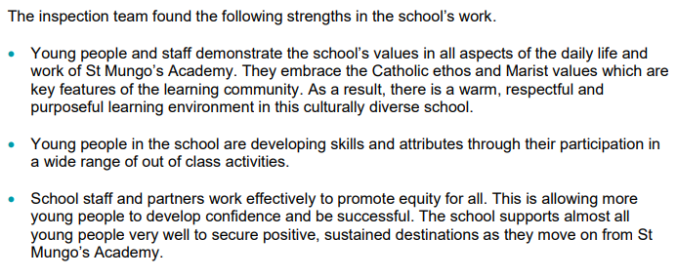
Inspection Report, January 2024
Notes:
Some key points from our inspection.

Slide 8
SQA Exam Performance In 2023:
80% of young people in S4 achieve at least 1 National 5/Level 5 qualification
One third of young people in S4 achieved at least 5 National 5/Level 5 qualifications
By the end of S5, 67% of young people achieved 5 National 5/Level 5 qualifications
By the end of S5, 62% of young people achieved 1 Higher qualification
By the end of S6, 86% of young people achieved 1 Higher qualification
By the end of S6, over half of our young people achieved 5 Highers (53.41%)
Notes:
Although your children will not be sitting exams for four years, we felt it important to highlight the improving picture of attainment in SQA exams. These show that we continue to perform better than the 'virtual comparator' which means if a young person attends St Mungo's Academy they would be expected to do better than if they attended a similar school in a similar area.

Slide 9
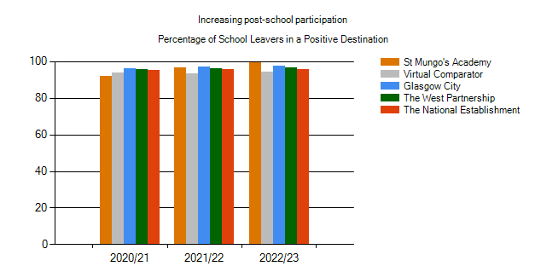
Post School Destinations, February 2024

Slide 11
Parental Engagement
“Parental engagement in supporting learning in the home is the single most important changeable factor in student achievement”
(Harris & Goodall, 2007)
85% of a young person’s time is spent at home or in the community.
The remaining 15% is at school.
Notes:
Parents are the first educators of children and without your support we are unable to achieve the best for your children. That means we need to work in partnership to ensure what we are trying to achieve for your children in school is fully supported at home.

Slide 12
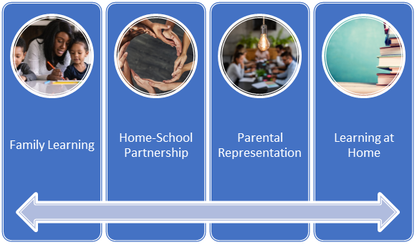
Notes:
Our parental engagement strategy has four strands:
Family Learning provides family members opportunities to learn together, increasing confidence and potentially leading to both adults and children engaging in further educational opportunities.
Home-school partnership is essential for families to understand the purpose of education and are able to support informed choices.
Parents have a right to influence their child's education either individually, through parent council or parent association.
Learning at home is essential as children only spend 15% of their time in school.

Slide 13
What can you do to help your child and the school?
in surveys/consultations and our Parent Council
school events
school values
high standards from your children
Nurture
good attendance and punctuality
Tell
us of any concerns
school policy and your childs learning
Participate
Attend
Reinforce
Expect
Support
Notes:
Please support us to support your child by engaging as much as possible.

Slide 14
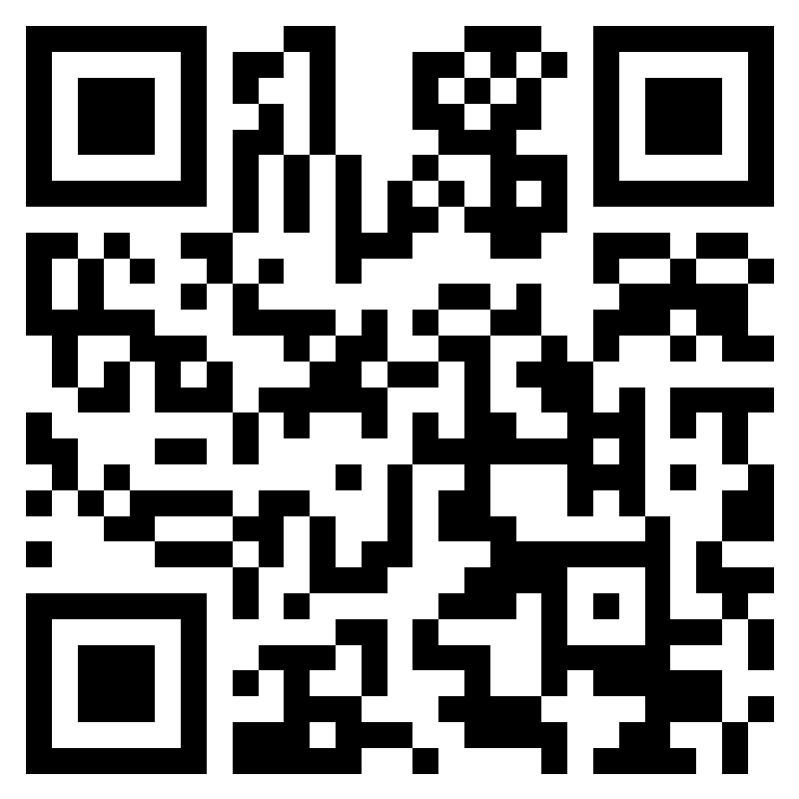
‘Blether’ – Scottish for engaging in conversation
Notes:
If you would like a blether with school staff to share opinions and ideas over a tea/coffee and cake please scan the QR code and provide your details. A member of the school staff will be in touch early in the new session to arrange this.

Slide 15
Attendance & Timekeeping
95% attendance = 10 days absence each year
One school year at 90% attendance = 19 days (almost 4 weeks) of learning missed!
85% attendance = 29 days (almost 6 weeks) of learning missed!
80% attendance = 38 days (almost two months) of learning missed!
If a child is 15 minutes late each day they will miss two full weeks of school each year.

Slide 16
Uniform
We recognises the importance of uniform in fostering a sense of pride and self-respect in our young people as members of a school community
Black trousers/skirts & white school shirt with tie
Black V-neck jumper or cardigan
Black shoes
Blazers optional
Uniform is equitable – it costs less than designer clothing
BE Schoolwear Open Evening 18th June 5pm – 6pm
35A Argyle St, Glasgow G2 8AH

Slide 17
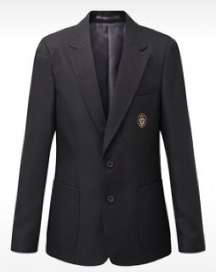
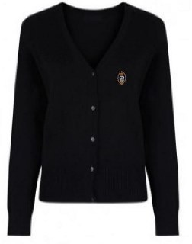
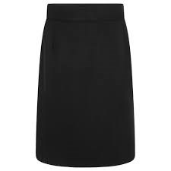
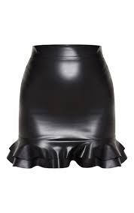
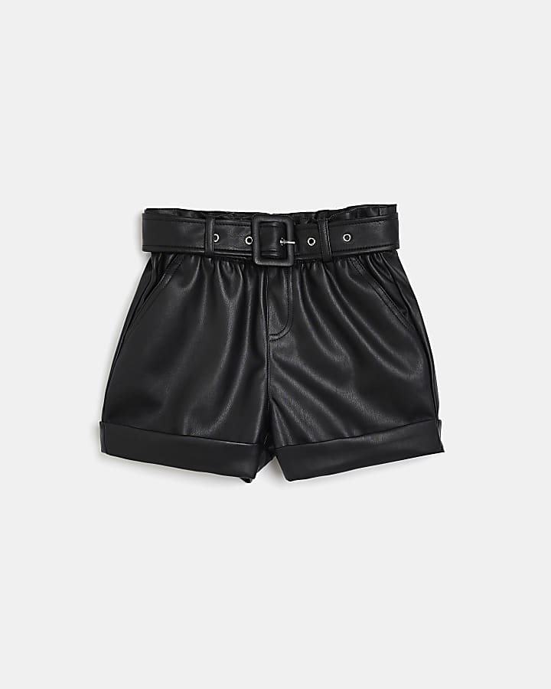
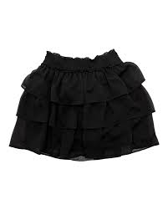
Notes:
Items which are acceptable school uniform are on the top row, items which are not acceptable are on the bottom row.

Slide 18
Uniform and Standards in PE
Full P.E kit is required for every lesson, even when injured or unwell
Sports T-shirt or plain t-shirt with no inappropriate slogans and no cropped t-shirts at any time
Outdoor activities - sweatshirt, jumper or jacket
Tracksuit bottoms, leggings or shorts - no jeans or jeggings
Suitable footwear
No jewellery
No fake nails
No mobile phones

Slide 19
Bringing Out The Best
No items of clothing should have designer or manufacturers' logos or labels visible
Hoodies are not permitted in the school building
All outdoor jackets taken off (apart from the school blazer) while inside the school building
Please bring a school bag each day
Remind your child to bring their iPad to school fully charged each day
iPads will be checked daily at tutor time
Mobile phones and earpods are not to be used

Slide 20
Children can be fussy eaters often leading to persistent health challenges
Poor diet affects behaviour, concentration and mood
The Fuel Zone provides a range of healthy meals at morning break and lunch to support healthier eating
Notes:
If you are registered for Parent Pay this should transfer over to St Mungo's Academy in August but we will also send out details of how to re-register. S1's are NOT allowed out of school during the school day and must eat in the canteen from the Fuel Zone or by bringing a packed lunch. Our food options are healthy and we also provide Halal options each day.

Slide 21
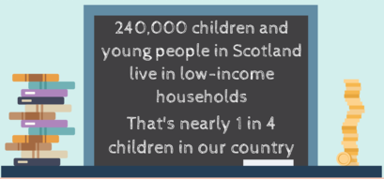
Notes:
Despite being one of the richest countries in The World we still have around one quarter of all young people living in low-income households. With the added cost of living crisis, increasing food and utility bills, times are tough. A significant number of our community also live in what the government class as poverty which is why our charity work supporting our community is vital. The impact of low-income on education is obvious and significant.

Slide 22
FISO (Financial Inclusion Support Officer) Sharon
07395832499 or email GlasgowSchools@gemap.co.uk.
Notes:
To support you we work with Sharon Graham from gemap to support families in obtaining additional benefits or other sources of income. Sharon has helped families in our community access over £250,000 of funds. Please contact Sharon if you feel she could be of help.

Slide 23
Caroline Prentice
Young Carers Education Worker
GAMH North East Carers Service
Tel 07912481534
Email c.prentice@gamh.org.uk
Notes:
We also work closely with the NE Carers centre to support families and children who could be classed as young carers, perhaps as they look after a family member (including parents) who suffer from ill-health. Caroline Prentice will be happy to help should you need it.

Slide 24
St Andrew House
Mrs Tracey
St Enoch House
Mr Parker
St Francis House
Mrs Moffatt
St Ninian House
Mr Kearns
Brother Walfrid House
Miss Ali
Notes:
Our school year groups are split between five House Groups, each a patronal saint or in Brother Walfrid's case a member of the Marist organisation who established St Mungo's Academy in 1858. The Marist Organisation works around The World to provide education for those less well off and we continue to have a close working relationship with them, sending some of our young people to France each year to meet with other schools. So although Brother Walfrid is most associated with Celtic FC, this is no the reason for choosing him, rather it's about the much wider charity and education he provided for the people of the East End.

Slide 25
Day One Arrangements Wednesday 14th August 2024 - Soft Start Day
Allocated classes will be shared with you by letter before August
Before 8.45am - Your child should report to the yard, check the class lists then line up in their sections in the yard (Weather permitting)
School starts at 8.45am
Timetables and dining cards will be issued by Key Adults
Welcome Mass early September
New S1 classes will be escorted to their Tutor Class by Key Adults
Pupils remain with Key Adult all morning
Normal Second day guided around school by S6 students

Slide 26
Inclusion Team
Linzi Mallon – Youth Worker
Paula Barrett – Family Support
Claire Thompson – Family Support
John Kennedy – Youth & Employability
Notes:
We use our Pupil Equity Funding (PEF) to employ our inclusion team from FARE. Each has a particular role in school, but generally they support the wellbeing of every young person. They also provide many other opportunities as shown on the next few slides.

Slide 27
Why we are here?
F.A.R.E provide additional support in developing young people’s personal, social and emotional skills as well as practical skills for life, learning and work.
We aim to support young people towards greater achievement in their education by offering support in areas which may be a barrier to their learning.

Slide 28
What supports do we offer young people?
1:1 support
Adapted for each YP at the center of our plans and outcomes
Groupwork
Anger, self-awareness & boundaries, coping strategies, self-esteem & confidence and much more
Break & Lunch Support
Our youth workers support YP to offer a friendly face, share their worries, concerns and wins.
Extra-Curricular Clubs
Mental Health Ambassadors, Rights Respecting Schools and after school clubs
Holiday Programmes, Responsive Support, Clothing/Food Support

Slide 29
What supports do we offer for parents & carer’s
Supporting parents/carer’s wellbeing
Informal link to establish positive and effective relationships with school and identify any concerns or barriers in the young person’s education
Working in tandem with young people and their families to achieve the best possible outcomes
Family learning
Information and support groups for families to gain skills and knowledge (Internet Safety, Literacy/Numeracy, Dyslexia, ASN, EAL, Young Carers, Digital Workshops)
Food, fuel, clothing, finance, housing support and advice

Slide 30
How did the inclusion team support you?
"They helped me come in to school without worrying everyday because I knew that I would have someone to come and talk to"​
"Always made sure that I knew I had someone and was a safe place to talk and be there"​
"By helping me in ways to control my anger or other emotions and checking on me from time to time"​
"By making me feel safe"

Slide 31
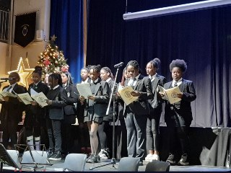
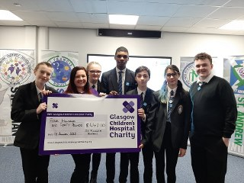
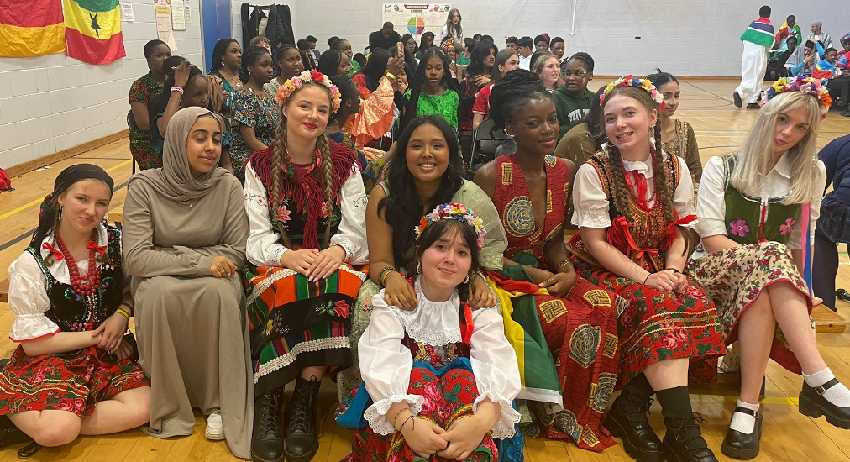
Pupils ARE the Life of St Mungo’s
Notes:
At St Mungo's your children will have many opportunities to lead and take part in activities which develop skills and contribute to the life of our community, e.g.
Building confidence through presentations and award ceremonies
Joining the choir or school bands
Raising funds for charity
Taking part in our culture day celebrating the diversity of our community
The next slide is a short clip showing our Afrobeats dance group who performed over 20 times in one day at the PARTIE anti-racism event at the City Chambers.

Slide 33
Pupil Presentation and Questions

Slide 34
Contact details
BGE Depute Head Teachers
Markruddy@glow.sch.uk
gw18whytelouise@glow.ea.glasgow.sch.uk
Call on 01415820260

